Slide 1

Predicting MLB Player offensive Production
Created By: Lucas Durflinger, Coby Lundgren, Kade Scharpman, and Razey Fahal

Slide 2

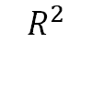
Executive Summary
Problem: Trying to find patterns between projected baseball statistics to predict player and position production on offense.
Data: Population of 621 MLB players’ projected statistics before the season started (excluding pitching exclusives).
Methods: Multiple Linear Regression, Exploratory Data Analysis, and Visualization
Measures: P-Values, Adjusted , and Variable Coefficients
Conclusions: Most significant factors are wRC+, SB, and Position in predicting WAR. Not 100% accurate since players may get injured or take time off for external reasons which would hurt their end season stats.
$$R^{2}$$

Slide 3
Problem Statement
Big Picture Question: What makes an MLB player have good offensive production?
Analytics Question: Which factors of an MLB players’ statistics show that their offensive production stands out more than the average player.

Slide 4
Data Source
Fangraphs’ 2025 Pre-Season Projections by Depth Charts. (NOTE: Our data was pulled before the 2025 MLB Season kicked off. It is very likely that there are minute differences between our data that was pulled in mid-March versus their final predictions that were most likely published right before the season started on March 27, 2025)
The full data contained 622 players, 7 of which were free agents at the time of gathering the data. They have no team association in our analysis.

Slide 5
Data Preparation
Removed and Filtered to 621 rows and 33 columns.
One player had since retired, so said player was removed from the pre-season predictions
No pitchers are in the dataset because pitchers no longer hit in the American or National League.
Limitations: Hard to predict defensive production without all the statistics (we are only looking for offensive production) and injuries to a player will throw off their actual stats compared to their pre-season prediction.

Slide 6
Data Description
Field | Type | Description | Dummy Variable
WAR | Numeric | Wins Above Replacement | Dependent | It tells how good the player is on both sides of the ball compared to the league average at the position.
Position | Categorical | Position of the Player | Independent | (Infield, Outfield, Designated Hitter/Utility) | Catcher = Reference, Others are listed a 1 for their category and 0 if not.
League | Categorical | American League vs. National League | Independent | Both Leagues create MLB, think of them as conferences in the NBA. | AL (National League = 0, American League = 1)
SB | Numeric | Stolen Bases | Independent | The predicted amount of stolen bases the player will have by the end of the season.

Slide 7
Data Description
Field | Type | Description | Dummy Variable
wRC+ | Numeric | Weighted Runs Created + | Independent | Translates a player’s ability to create runs, 100 represents league average.
OPS | Numeric | On Base Plus Slugging | Independent | Shows their ability to get on base plus their power hitting ability. Players who hit a lot of homeruns will have a higher OPS.
BB% | Numeric | Base on Balls % | Independent | The technical term for getting walked by a pitcher. Players with high BB% have good patience and are good at working the strike zone.
AVG | Numeric | Batting Average | Independent | Tells how likely a player is to hit the ball. 0.200 is a mediocre average, but 0.300 can get you into the Hall of Fame.

Slide 8
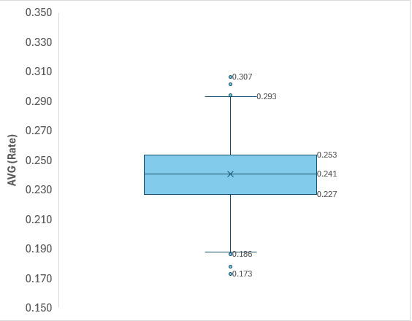

Methodology: Exploration
Calculated descriptive statistics and frequencies for our variables.
Constructed multiple variables.
Key findings: The mean batting average for a player is 0.241. The league batting average is very evenly distributed with few outliers on both sides. 50% of the league boasts a batting average between 0.227 and 0.253.

Slide 9
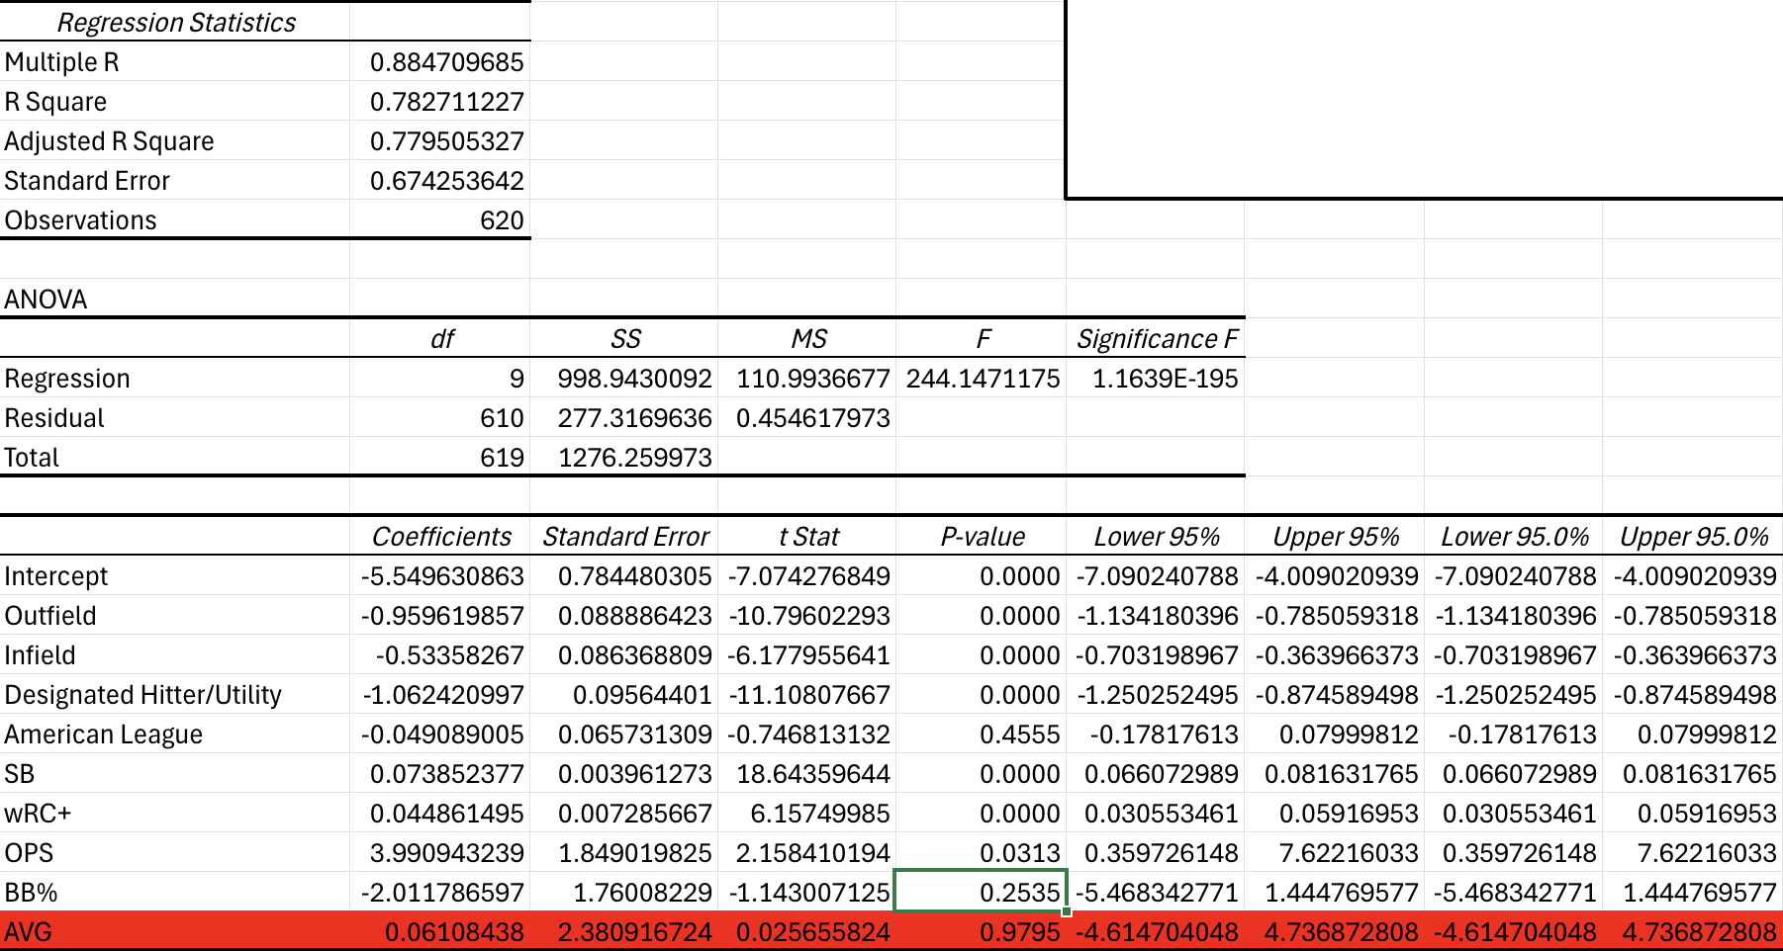
Methodology: Regression
Constructed a multiple regression model that predicts WAR based on 7 different variables.
Position, League, SB, wRC+, OPS, BB%, AVG
Key findings:
Model is a good fit for the data, as the Adjusted R-Square is 0.78.
Significance-F is very low meaning our variables are significant.
Only 3 variables are greater than 0.05.

Slide 10
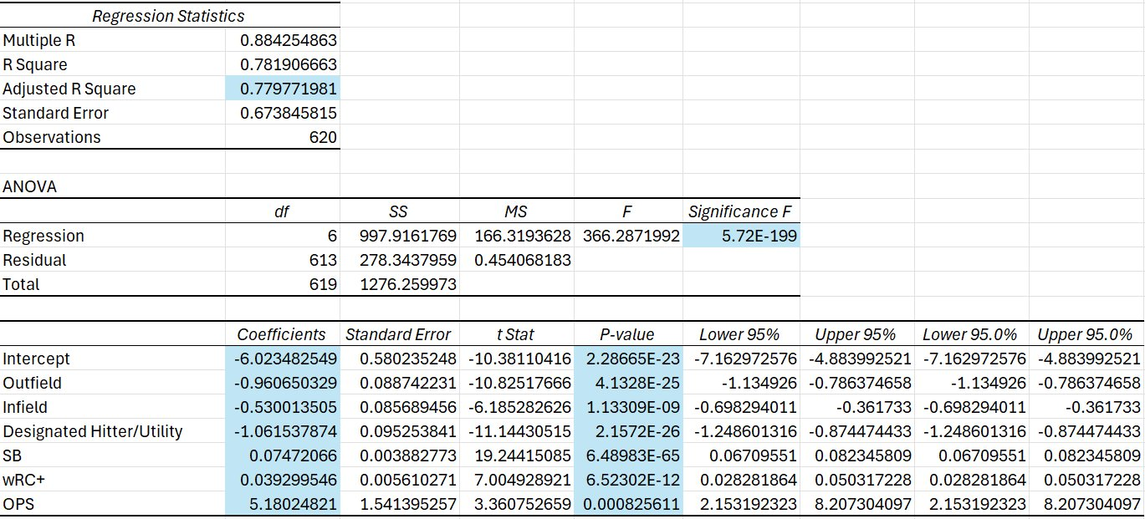
Methodology: Parsimonious Model
Found a parsimonious multiple regression model through backwards selection that predicts WAR based on four different variables.
Position, wRC+, OPS, SB
Key findings:
Model is a good fit for the data, as the Adjusted R-Square is 0.78.
Significance-F is a microscopically low number, indicating that this model is vastly superior to one that only uses a constant intercept.

Slide 11
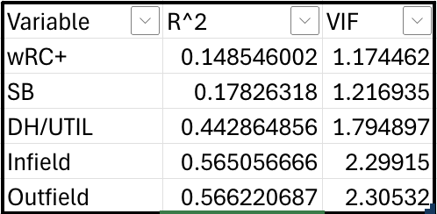

Methodology: Multicollinearity
Calculated Variance Inflation Factor (VIF) for each variable.
All scores are below 2.5 which indicates little to no collinearity between all the variables.

Slide 12
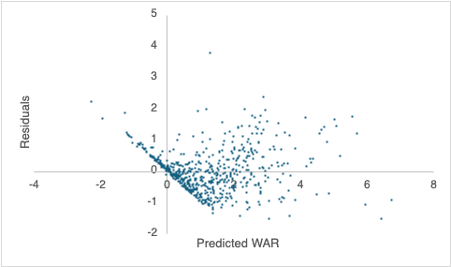
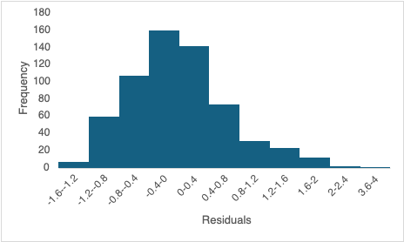
Methodology: Residuals
Created Residual Plots to check model assumptions.
Our residual plots are centered around 0 with no apparent patterns and seem to be randomly scattered.

Slide 13
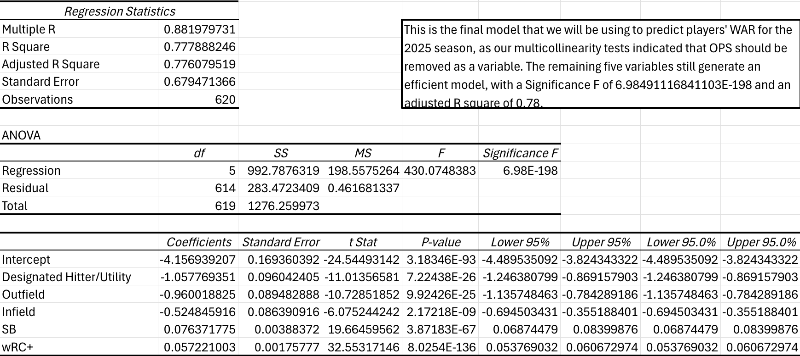
Final Model without OPS

Slide 14
Conclusions
wRC+, SB, and Position were all significant predictors of WAR.
The final model has a high Adjusted R-Squared value meaning that our data fits the model well.
Our residual plots show random scatters with no apparent patterns while still being centered around zero.
Not a perfect prediction model unless nobody gets injured or nobody has to take games off for external issues like family matters, legal trouble, etc.
There is still likely to be other statistics that can help our model prediction as well.

